Slide 1

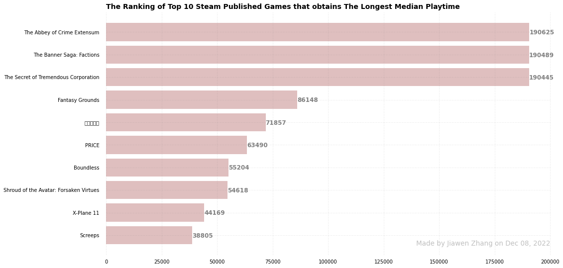
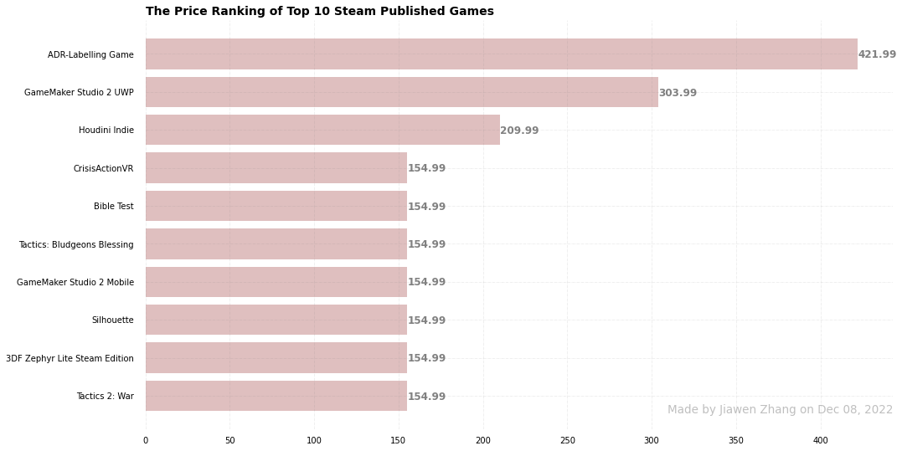
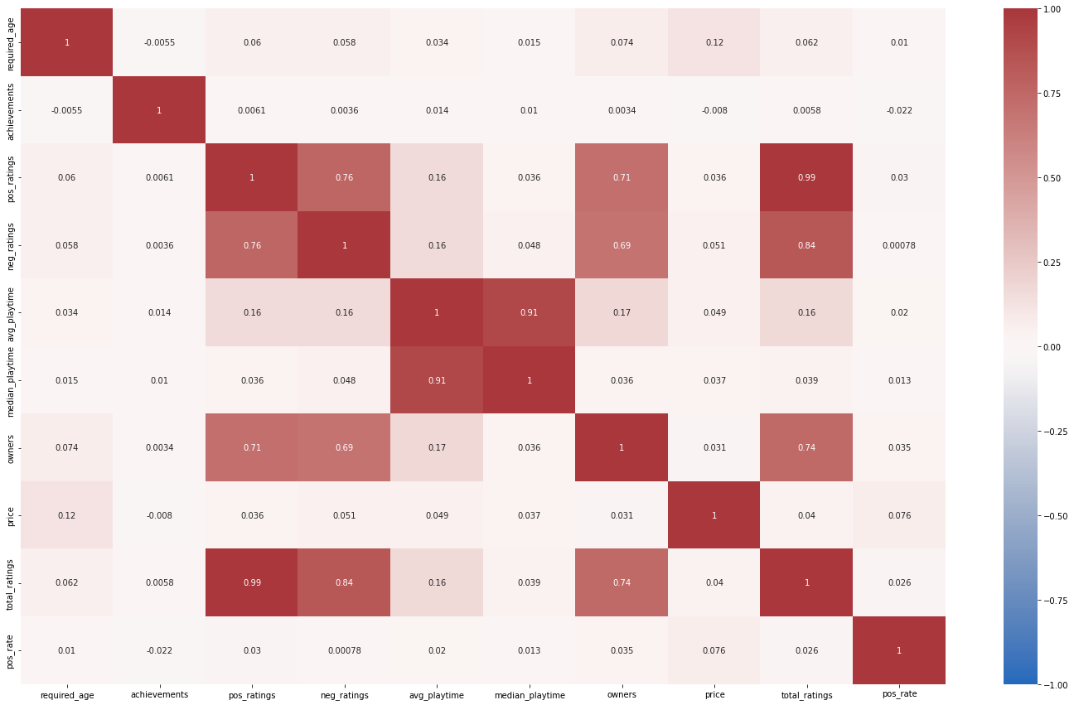
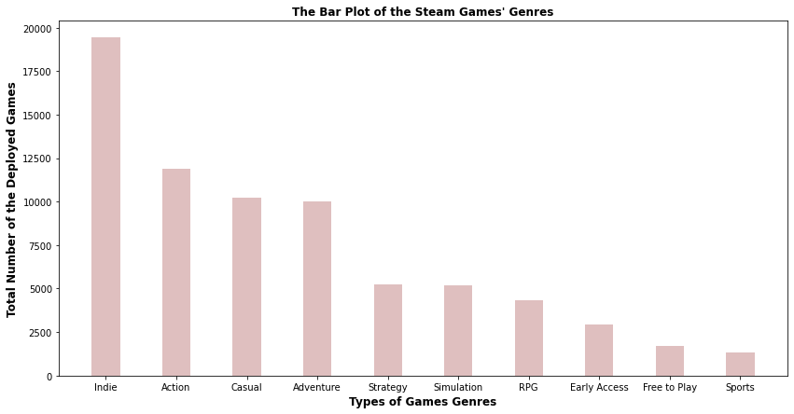
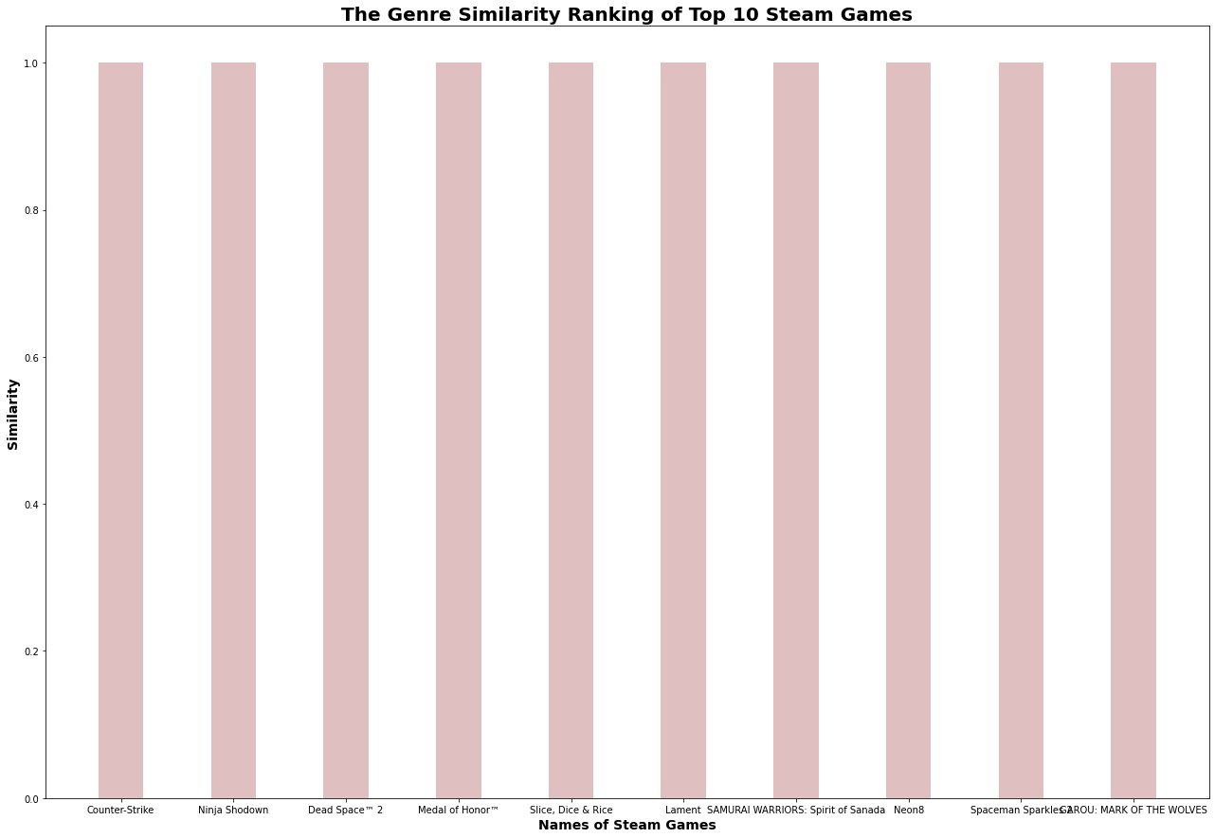
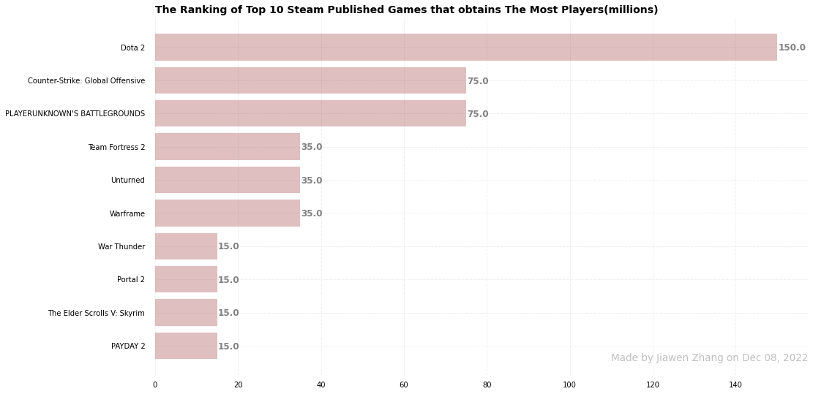
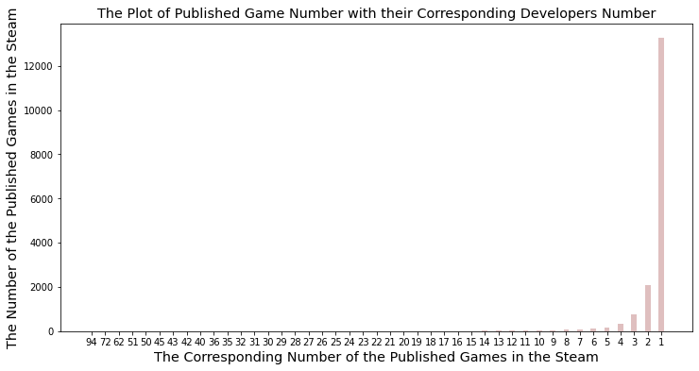
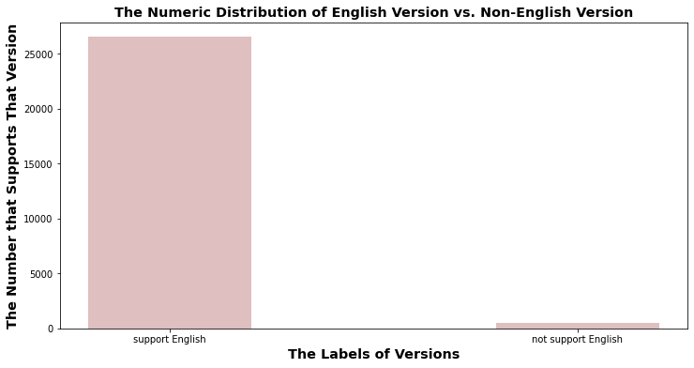
Research on the Coefficient that Influences Steam Games’ Popularization
Team Member: Jiawen Zhang | E-mail Address: jiawenz@umich.edu | Data Mining
Introduction
Feature Engineering
Data Mining
Steam is a highly active platform that runs millions of games and other applications. One of the Kaggle datasets offer multiple features, so some data exploration and testing are conducted, and expected relationships are under exploration to see the potential connection.
Explorate some data information
Practice some data visualization techniques
Utilize the skills of data mining to apply some structure in the data
Experiment some machine learning models to predict the coefficients that trigger how to make games popular
Data Exploration
Steam Games with their Corresponding Categories
Counter-Strike: Multi-player ,Online Multi-Player ,Local Multi-Player ,Valve Anti-Cheat enabled.
Deathmatch Classic: Multi-player ,Online Multi-Player ,Local Multi-Player ,Valve Anti-Cheat enabled.
Team Fortress Classic: Multi-player ,Online Multi-Player ,Local Multi-Player ,Valve Anti-Cheat enabled.
SLEEPOVER: Multi-player ,Online Multi-Player ,Local Multi-Player.
Fatal Velocity: Physics Combat: Multi-player ,Online Multi-Player ,Local Multi-Player.
Epic Royal: Multi-player ,Online Multi-Player ,Local Multi-Player.
Ricochet: Multi-player ,Online Multi-Player ,Valve Anti-Cheat enabled.
Smash team: Single-player ,Multi-player ,Online Multi-Player ,Local Multi-Player.
Tennis Arcade VR: Single-player ,Multi-player ,Online Multi-Player ,Local Multi-Player.
Steam Games with their Corresponding Genres
Counter-Strike: Single-player ,Multi-player ,Online Multi-Player ,Local Multi-Player.
Ninja Shodown: Single-player ,Multi-player ,Online Multi-Player ,Local Multi-Player.
Dead Space™ 2: Single-player ,Multi-player ,Online Multi-Player ,Local Multi-Player.
Medal of Honor™: Single-player ,Multi-player ,Online Multi-Player ,Local Multi-Player.
Slice, Dice & Rice: Single-player ,Multi-player ,Online Multi-Player ,Local Multi-Player.
Lament: Single-player ,Multi-player ,Online Multi-Player ,Local Multi-Player.
SAMURAI WARRIORS: Spirit of Sanada: Single-player ,Multi-player ,Online Multi-Player ,Local Multi-Player.
Neon8: Single-player ,Multi-player ,Online Multi-Player ,Local Multi-Player.
Spaceman Sparkles 2: Single-player ,Multi-player ,Online Multi-Player ,Local Multi-Player.
GAROU: MARK OF THE WOLVES: Single-player ,Multi-player ,Online Multi-Player ,Local Multi-Player.
Dragon`s Checkers: Single-player ,Multi-player ,Online Multi-Player ,Local Multi-Player.
Data Preprocessing
Classify categorical data, numeric data and some other abstract data
Transform some abstract data into reasonable data format, such as numeric data, categorical data, list etc.
Split the original dataset into three datasets, including a numeric dataset, a categorical dataset and a abstract dataset
The above heat map suggest the potential correlation between different game features, and strong correlations between pos_ratings, neg_ratings and total_ratings, and between median_playtime and avg_playtime are detected.
Machine Learning
The model is devoted to predict the number of game owners based on the filtered and manipulated features, including ‘pos_ratings’, ‘neg_ratings’, ‘total_ratings’. Several regression models are involved in the tryout process here, but they all received unhealthy responses, such as mean squared error, though standard scaler helps the scaling of the training data.
Regression Model Selection
Ridge Regression
Lasso Regression
Linear Regression
Bayesian Ridge Regression
Gradient Boosting Regression
Feature Tryouts
The process of feature selection depends on the performance of those features in preliminary stages of data preprocessing and data exploration, so few features are not in the final deeper data research, such as data mining and machine learning.
Different techniques were deployed to explore the potential relationship between features, correlation is used to see the connection between numeric features, and data visualization techniques are deployed to see categorical relationships.
The original dataset entail 16 features except the App ID and the App Name. After personalized customizations, three data frames are born, and they focus on categorical data, numeric data and abstract data types by respectively.
Categorical Data Frame：All the columns are original from the kaggle dataset, and they are merely split from the original dataset
Numeric data frame：Some columns are inherits from the original kaggle dataset, whereas some of them, such as ‘pos_rate’ that the percent of the positive ratings over total ratings, went through customized transformations to appear
Abstract data frame： All the features are transformed from some original features from the kaggle dataset
Future Work
Set the benchmark for successful game, i.e. a game with owners number is over 1 million, and utilize one hot encoder to create more features, and then create categorical models based on all the categorical features, including new ones and old ones.
Consider Different abstract types
Focus on the categorical direction
Made by Jiawen Zhang on Dec 09, 2022

